Slide 1
Welcome to - Bangalore Monitoring & Observability Meetup

Slide 2
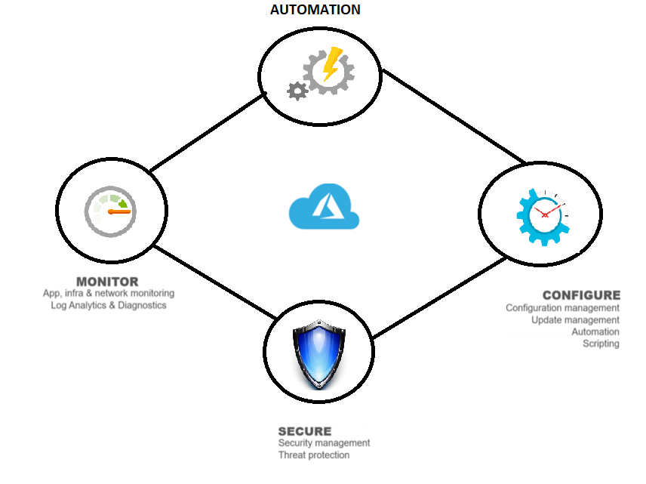
Monitoring and Managing the Infrastructure with Azure Monitor and Azure Automation
Keshav Jain

Slide 3
About me ☺
Around 12 years of experience in IT Infrastructure Management.
Working as Senior Professional System Engineer in DXC.Technology.
Prior to this, I was in Microsoft GTSC Bangalore for around 7+ years and worked on Azure IAAS, Azure Monitor, Azure Automation, SCOM, Orchestrator and other system center tools.
I started my career at Capgemini Mumbai as an Application Packaging Engineer. I used to develop Windows Installer (.msi) packages using InstallShield, Orca, etc.
Reach out to me at :-
https://www.linkedin.com/in/keshav-jain-016427121/ https://twitter.com/KeshavJain13

Slide 4
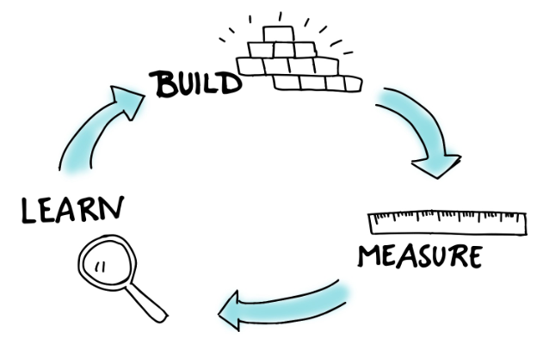
Lets start with Philosophical Quote ☺
Monitoring is one of the fundamental aspects of the popular Build-Measure-Learn philosophy.

Slide 5

Monitoring
Monitoring is the act of collecting and analyzing data to audit the performance, health, and availability of your resources.
Know - what devices and applications make up your Infrastructure.
Keep an eye on those devices in terms of availability, health status and performance and assessing their performance periodically.
Reporting to provide details about what has happened/is happening.
And many more things…

Slide 6
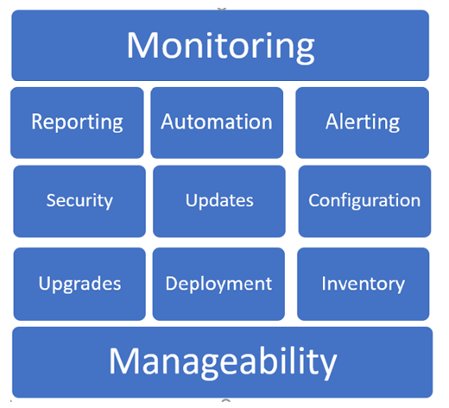
Only Monitoring ?
Nobody wants to do "Only Monitoring".
Everyone wants :-
Resiliency in their infrastructure.
Fix the problem ASAP.
Predict the failures and outages.
Assess the health of the infrastructure.
Keep the data for future assessment.
In simple words, when something goes wrong, the system should have the power to automatically ﬁx it or automatically alert someone or even automatically create a ticket in a service desk and assign it to a queue.

Slide 7
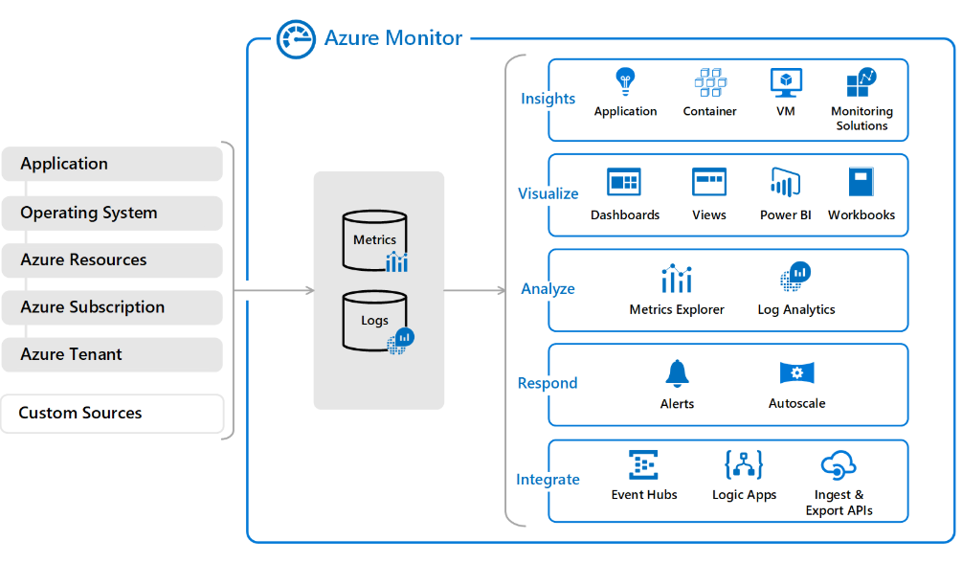
Azure Monitor
It provide full observability into your applications, infrastructure and network and make it easier to discover a potential root cause when something fails.
Provides easy mechanism for collecting telemetry Data.
Proactively identify issues and automatically respond to alerts.
Flexible enough to get integrated with partner integrations to help you bring your DevOps, ITSM, SIEM and other custom tools.

Slide 8
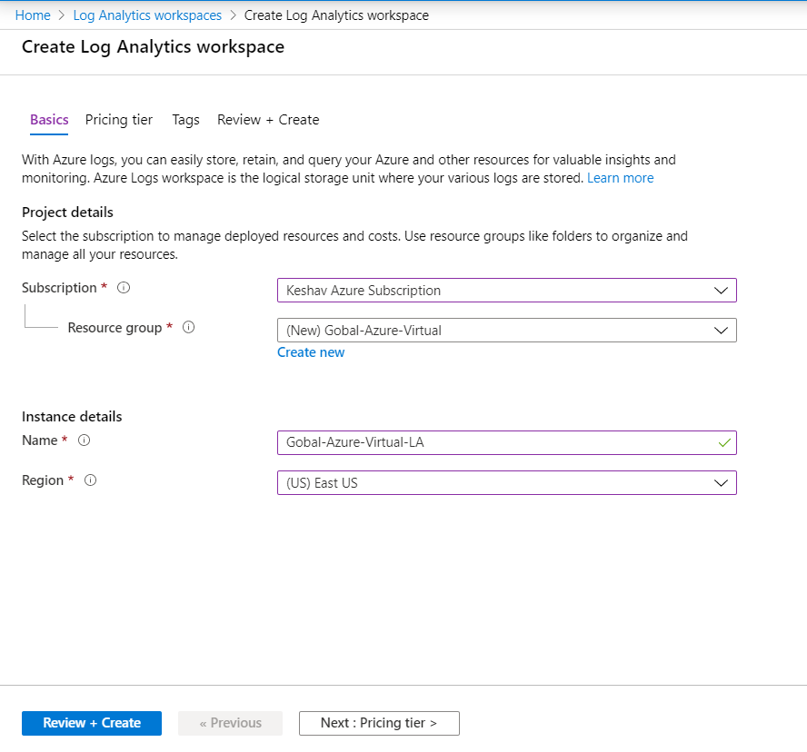
Lets Configure the Monitoring !
Log data collected by Azure Monitor is stored in a Log Analytics workspace.
Workspace stores collected machine data in a specified region.
Here you can Manage and protect Azure or AWS, Windows Server or Linux with a cost-effective, all-in-one cloud IT management solution.

Slide 9
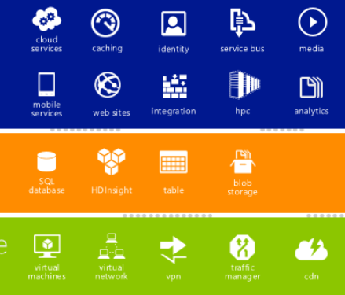
Monitoring Resources from Azure Environment
Almost all Azure resources can send telemetry to the Log Analytics Workspace.
Most of the Azure resource have option to send their diagnostic data to Azure Monitor workspace through Diagnostic settings.
We can easily collect the Metric data from the Azure resources.
Notes:
This telemetry can provide insight into operations that were performed within an Azure resource.
Metrics are numerical values that describe some aspect of a system at a particular time. Metrics in Azure Monitor are lightweight and capable of supporting near real-time monitoring scenarios.

Slide 10
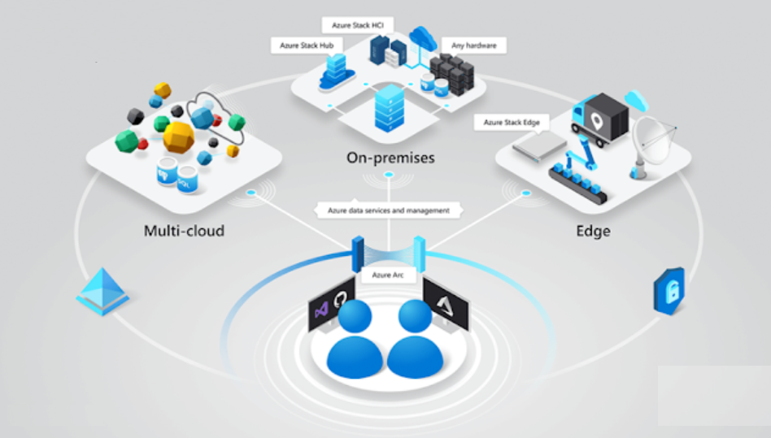
Monitoring Hybrid Infrastructure
Digital transformation is ushering in a new era of hybrid IT– a combination of both Cloud and On-Premises – that allows businesses to innovate while meeting their own unique organizational needs. Azure Monitor has capabilities of monitoring the Devices running in Hybrid Infrastructure :
- Machines running in any cloud.
- Machine running on On-premises.
- Devices having any Operation systems like Windows, Linux, Unix.

Slide 11
Azure Monitor Solution
Azure Monitor has various solutions to monitor the infrastructure. These solutions provide additional insight into the operation of a particular application or service. Some of the solutions related to Infrastructure monitoring are listed below :-
AD Assessment | Malware Assessment
AD Replication Status | Update Management
Network Performance Monitor | Upgrade Readiness
Office 365 Analytics | Wire Data 2.0
SQL Assessment | Service Map

Slide 12
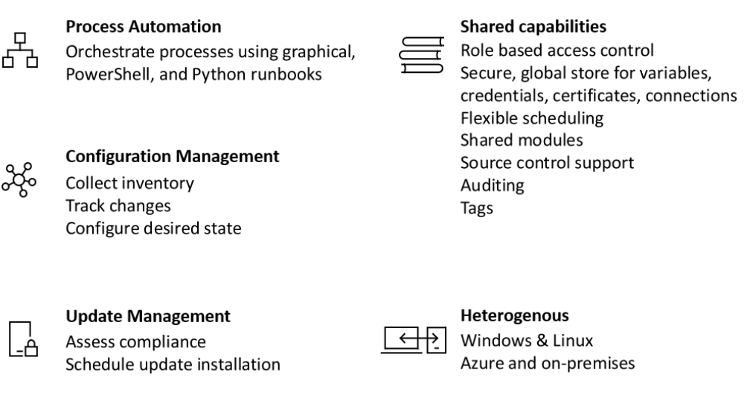
Azure Automation.
Azure Automation delivers a cloud-based automation and configuration service that provides consistent management across your Azure and non-Azure environments.
Build / Deploy resources
Configure VMs.
Monitor
Protect
Govern

Slide 13
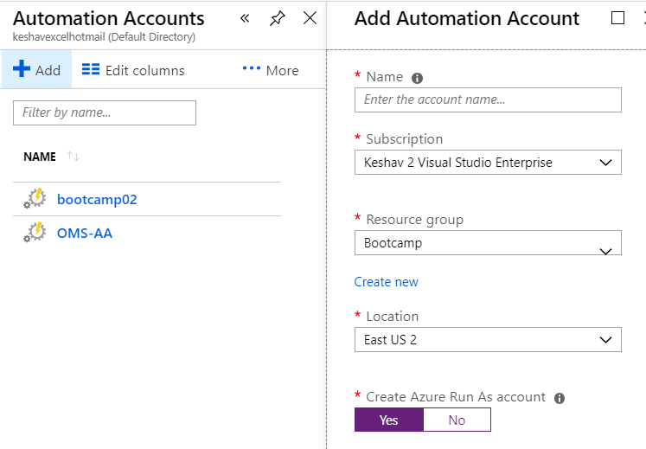
Configuring the Azure Automation Account.
Automation to configure and automate operational tasks across a hybrid environment.
Control hybrid environments.
Integrate management systems using serverless runbooks.
Ensure consistent management for Windows and Linux.

Slide 14
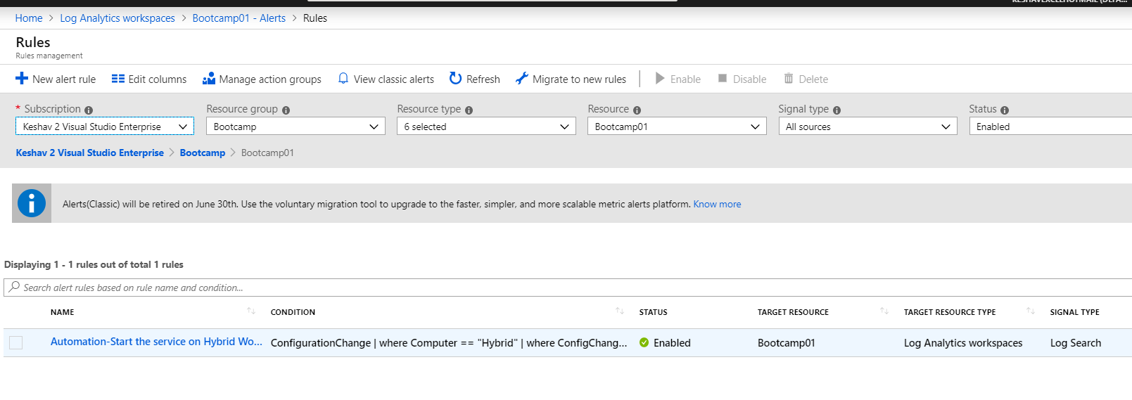
Auto correcting the issues with Azure Alerts.
Azure Alerts proactively notify you when important conditions are found in your monitoring data. They allow you to identify and address issues before the users of your system notice them.

Slide 15
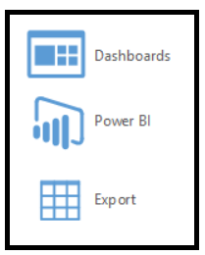
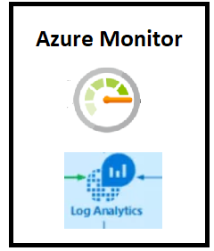
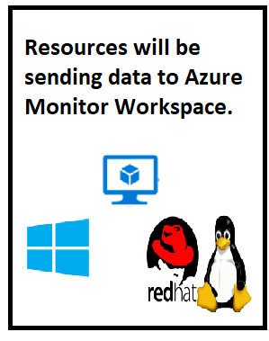
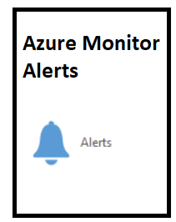
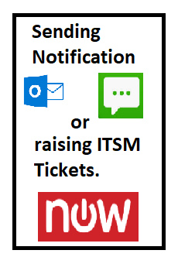
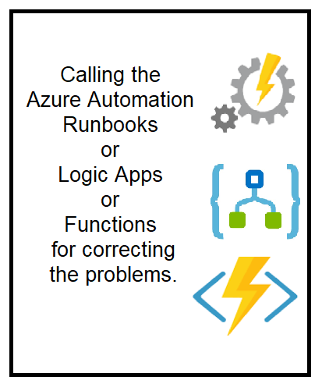
Auto correcting the issues.

Slide 16
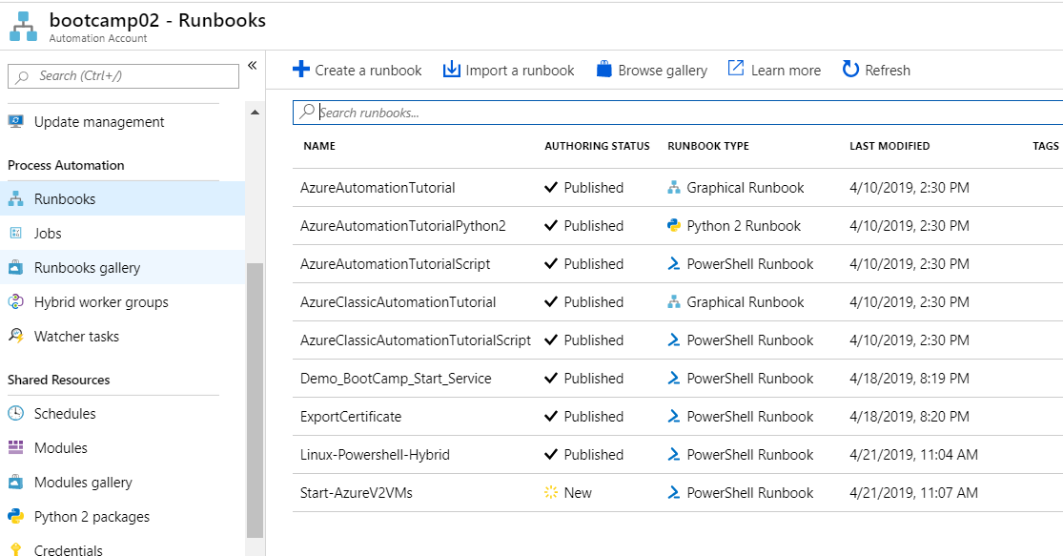
Running runbooks thru Azure Automation.
With Azure Automation we can automate frequent, time-consuming, and error-prone cloud management tasks.

Slide 17
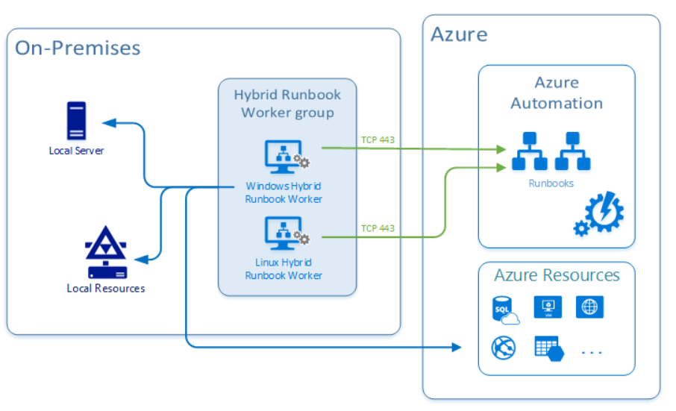
Executing the Runbook on Hybrid Environment
Runbooks in Azure Automation might not have access to resources in other clouds or in your on-premises environment because they run on the Azure cloud platform.
We can use the Hybrid Runbook Worker feature of Azure Automation to run runbooks directly on the computer that's hosting the role and against resources in the environment to manage those local resources.

Slide 18
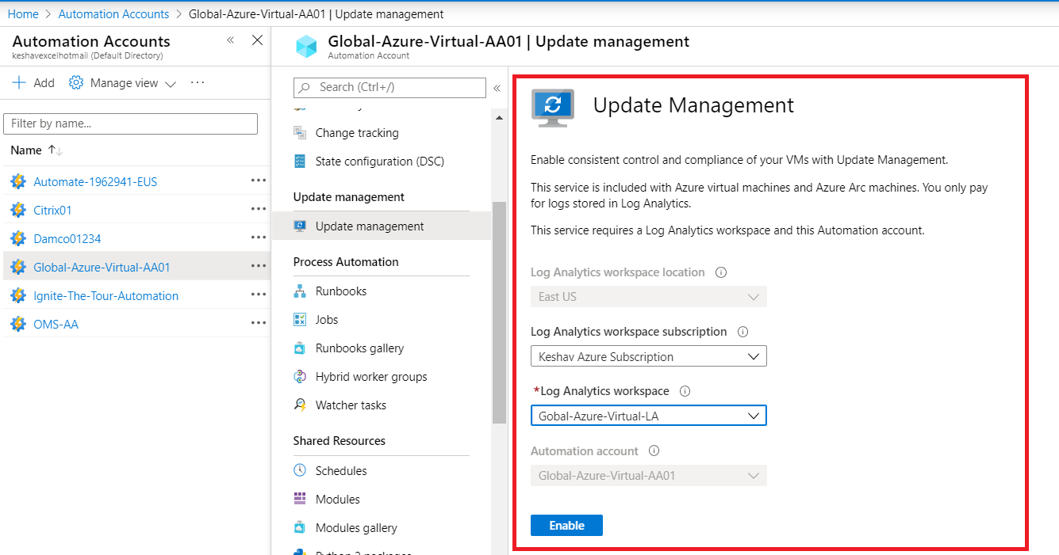
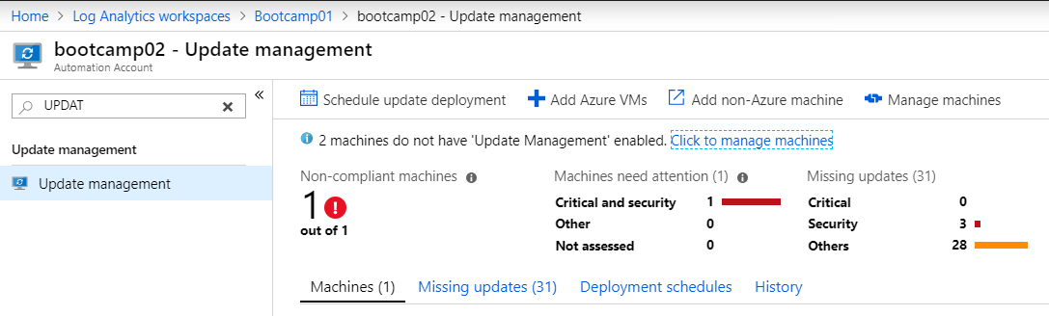
Update Management
Azure Update Management is a service included as part of your Azure Subscription that enables you to assess your update status across your environment and manage your Windows and Linux server patching from a single pane of glass, both for on-premises and Azure, or in other cloud providers.

Slide 19
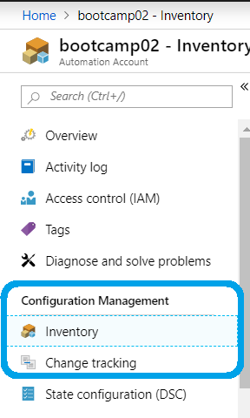
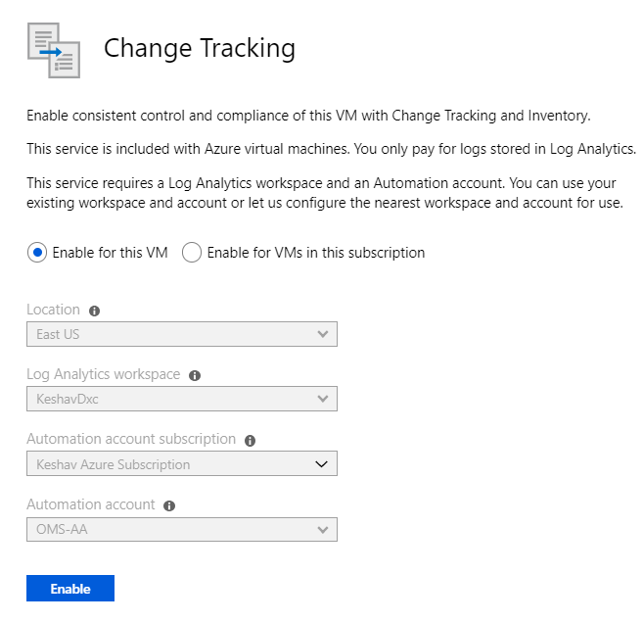
Inventory and Change Management
Get an inventory of operating system resources including installed applications and other configuration items.
Track changes across services, daemons, software, registry, and files to promptly investigate issues. The inventory of your VM in-guest resources gives you visibility into installed applications as well as other configuration items you wish to track.

Slide 20
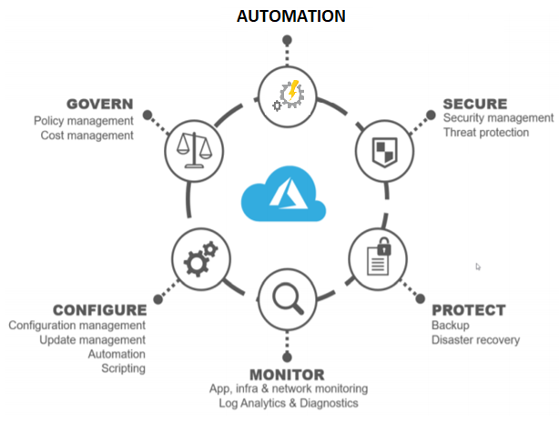
Monitoring the infrastructure and then triggering a Automation when something goes wrong.
Dashboards to analyze the health of the infrastructure.
Quick deployment of the resources by automating their deployment with use of ARM templates, PowerShell script, Azure DSC.
Controlling the cost of the Azure Infrastructure by scaling them down.
Deploying and managing the updates on windows or Unix or Linux machines.
Assessing the Machines\Applications before they goes for upgrades.
Integrating it with ITSM tools and other tools

Slide 21
Thanks

